Slide 1
IT-related Electricity Demand in AEO 2002
Erin E. Boedecker
Energy Information Administration
NEMS/AEO Conference
March 12, 2002

Slide 2
IT-related Electricity Use in Buildings AEO 2002 Projections
Perspective
Detailed Reference Case Projections
Drivers/Assumptions
Alternative Assumptions/Effects on Projections

Slide 3
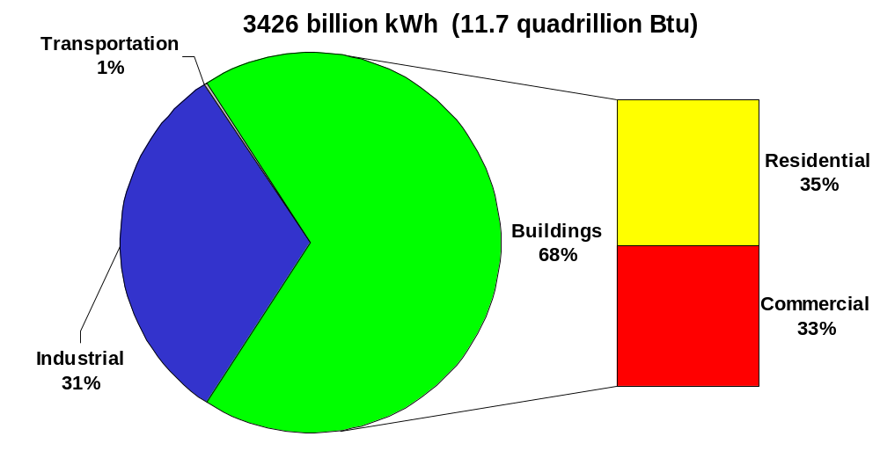
Site Electricity Consumption in 2000
Source: Energy Information Administration, Annual Energy Outlook 2002 reference case.

Slide 4
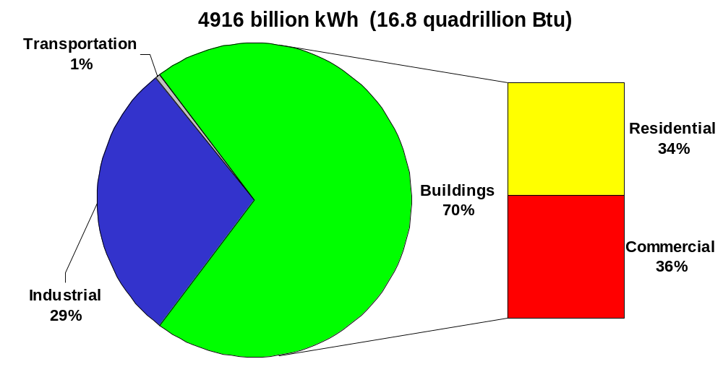
Site Electricity Consumption in 2020
Source: Energy Information Administration, Annual Energy Outlook 2002 reference case.

Slide 5
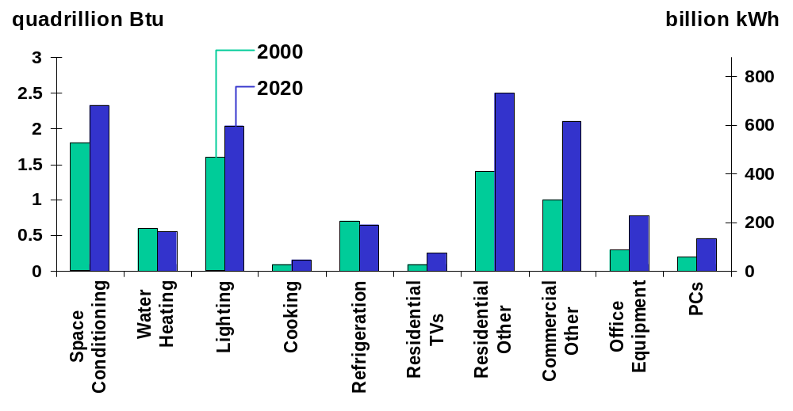
Electricity Consumption in the Buildings Sectors, 2000 and 2020
Source: Energy Information Administration, Annual Energy Outlook 2002 reference case.

Slide 6
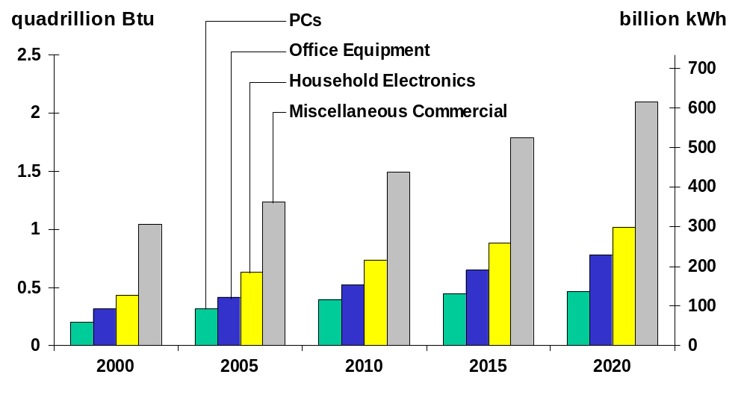
IT – Related Electricity Consumption in the Buildings Sectors, 2000-2020
Source: Energy Information Administration, Annual Energy Outlook 2002 reference case.
Notes:
Focuses in on IT-related uses in buildings
Projected avg. annual growth 2000-2020; category includes
PCs 4.3% /yr (residential 4.5%, commercial 4.2%)
Residential CPUs & monitors only
commercial also includes terminals & laser/ink jet printers
Office Equipment 4.6% /yr
Mainframe & server computer systems in dedicated “computer rooms”
Also copiers, faxes, cash registers, typewriters, etc.
Household Electronics 4.4% /yr
PC peripherals such as scanners & printers, and audio/video devices
Rechargeable devices – battery chargers, toothbrushes, flashlights, tools, kitchen appliances, razors, lawn mowers and trimmers
Other devices – clocks, alarm systems, intercoms, garage dr openers
Miscellaneous Commercial 3.5% /yr
Internet/network related infrastructure & telecom equipment
Myriad of other uses; ATMs, food prep, medical, A/V, plug load

Slide 7
Principal Drivers and Assumptions
Households/Floorspace Growth
  Number of residential households projected to grow 1% annually between 2000 and 2020
  Projected commercial floorspace growth of 1.7% per year between 2000 and 2020
Additional Penetration
  PCs in 51% of households in 2000, 65% of commercial buildings in 1999
  Limits on PCs per household & per employee

Slide 8
Principal Drivers and Assumptions (cont.)
Additional Penetration (cont.)
  Growth in household electronics, other office equipment, and miscellaneous uses based on recent trends
Commercial Indirect Consumption
  Cooling, ventilation, miscellaneous uses account for assumed growth in data centers

Slide 9
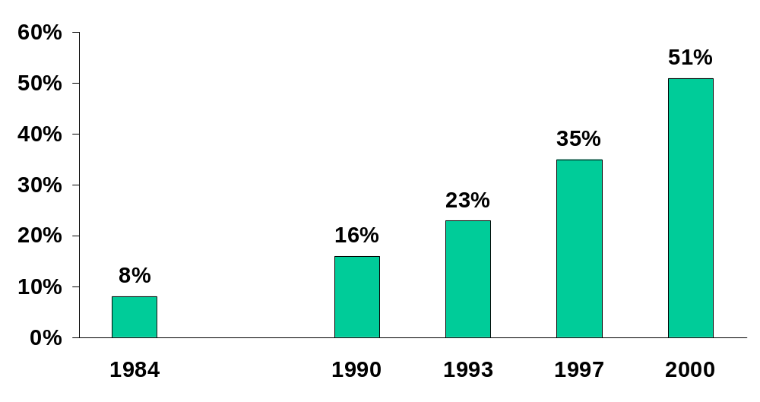
Percent of Households with a Computer
Source: 1984 and 2000 estimates: Home Computers and Internet Use in the United States, September 2001, U.S. Census Bureau. 1990, 1993, and 1997 estimates: Energy Information Administration, Residential Energy Consumption Surveys.

Slide 10
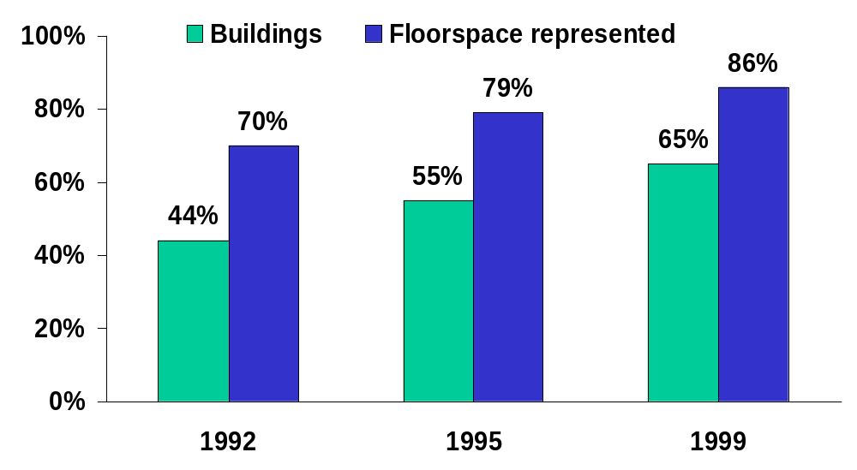
Share of Commercial Buildings with PCs
Source: Energy Information Administration, Commercial Energy Consumption Surveys.

Slide 11
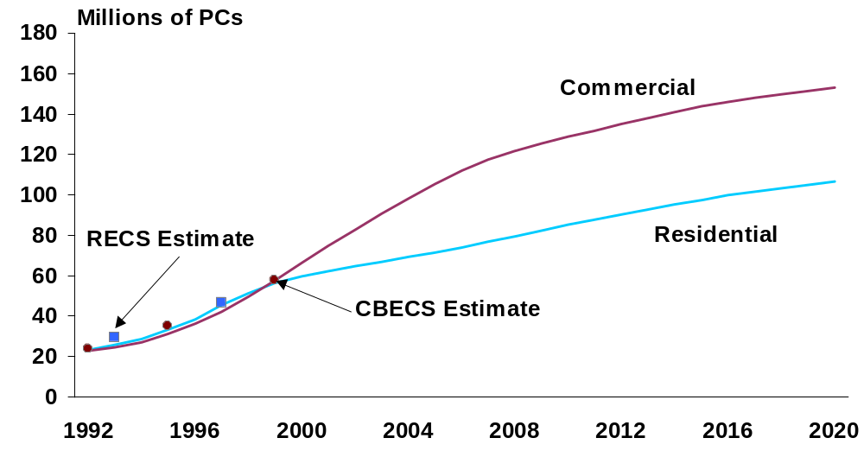
PC Projected Stock Estimates
Source: Energy Information Administration, Residential and Commercial Energy Consumption Surveys, and Annual Energy Outlook 2002 reference case.

Slide 12
PC-related Assumptions
Consumption per Unit
  Energy use in each mode
  Share of year spent in each mode
Monitors
  Display area
  LCD technology
Equipment Life
Energy Star Sales & Enabling Rates

Slide 13
Commercial PC Assumptions:
Unit Energy Consumption
 | Active | Standby | Suspend | Off
PCs | 55 to 67 (9%) | N/A | 15 (57%) | 3 (34%)
Monitors:
CRT LCD | 86 to 122 23 to 41 (9%) | 15 9.5 (5%) | 8 8 (61%) | 3 0.6 (25%)
Printers | 69 to 90 (6%) | 46 to 64 (39%) | 20 to 28 (35%) | 1 (19%)
Units: watts
(% of year in mode)

Slide 14
Residential PC Assumptions:
Unit Energy Consumption
 | Active | Standby | Suspend | Off
PCs | 55 to 67 (13%) | N/A | 15 (12%) | 0 (75%)
Monitors:
CRT LCD | 79 to 92 23 to 32 (13%) | N/A | 8 8 (12%) | 0 0 (75%)
Units: watts
(% of year in mode)

Slide 15
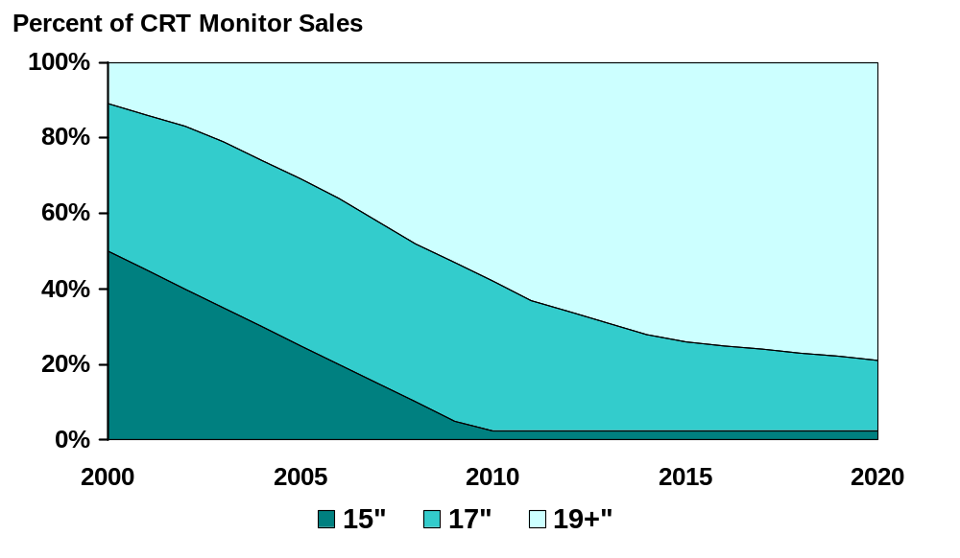
Commercial PC Assumptions:
CRT Display Area

Slide 16
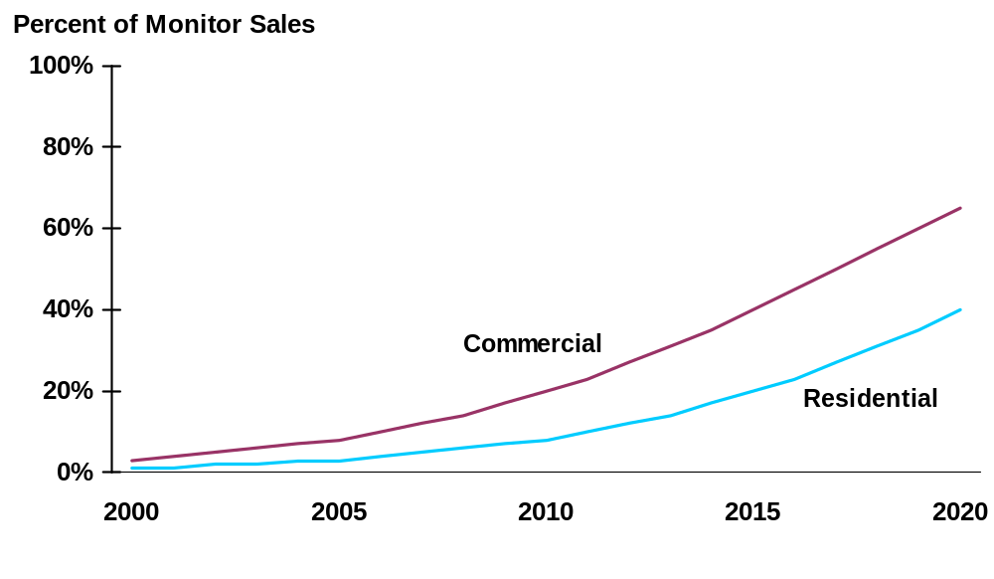
PC Assumptions: LCD Monitor Adoption

Slide 17
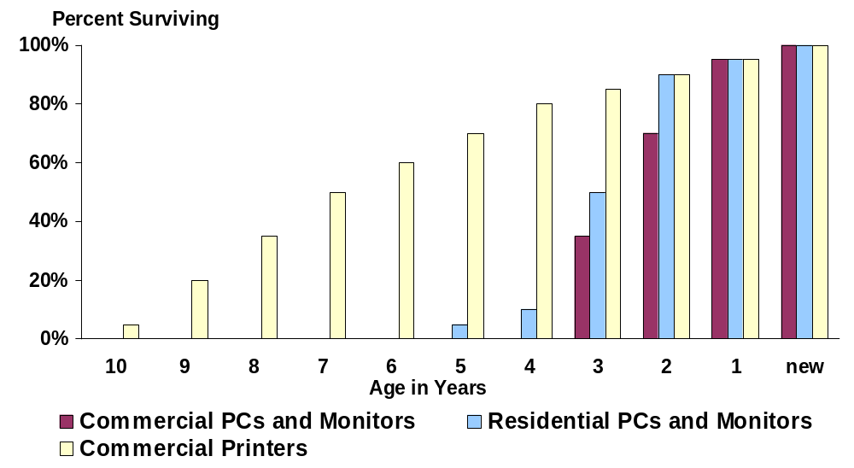
PC Assumptions: Equipment Life

Slide 18
PC Assumptions:
Energy Star Sales & Enabling Rates
 | Share of Sales | Share Enabled
PCs | 50% in 2001 increasing to 90% by 2005 | Commercial - 25% in 2001 increasing to 35% by 2005 Residential - 20% throughout forecast
Monitors | 95% throughout forecast | 59% throughout forecast
Commercial Laser/Ink Jet Printers | 92% in 2001 increasing to 100% by 2004 | 76% throughout forecast

Slide 19
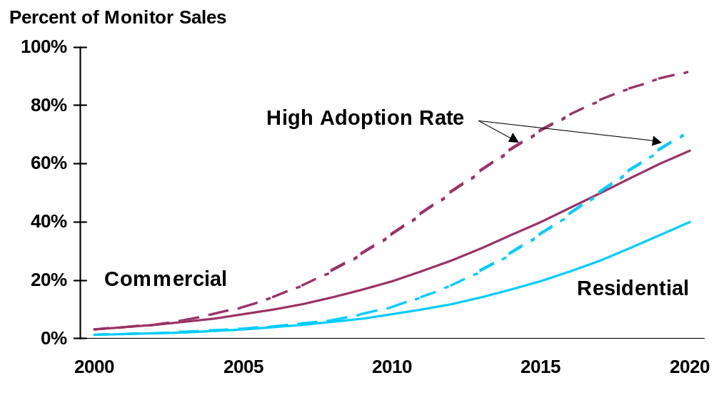
Alternate PC Assumptions:
LCD Technology Adoption

Slide 20
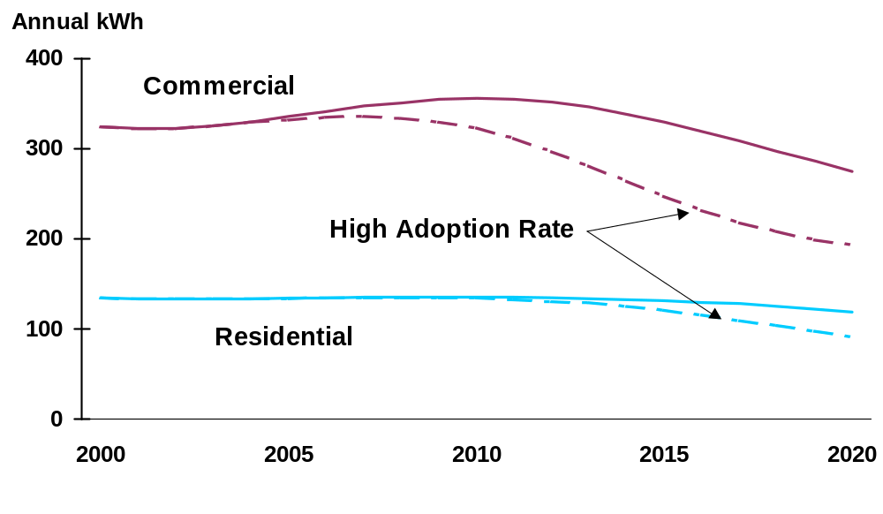
Per Monitor Consumption (Composite):
LCD Technology Adoption

Slide 21
IT-related Electricity Demand in AEO 2002
Erin E. Boedecker
Energy Information Administration
NEMS/AEO Conference
March 12, 2002

